Slide 1

The human brain …
人类的大脑
… tricks us whenever it can!
随时都在欺骗我们！

Slide 2
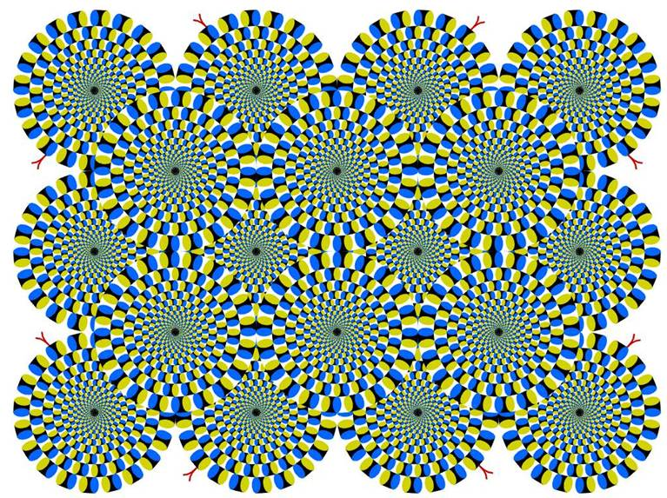
If something‘s rotating – go home, you need a break! *g*
如果感到有东西在转动 – 你该回家休息一下了！

Slide 3
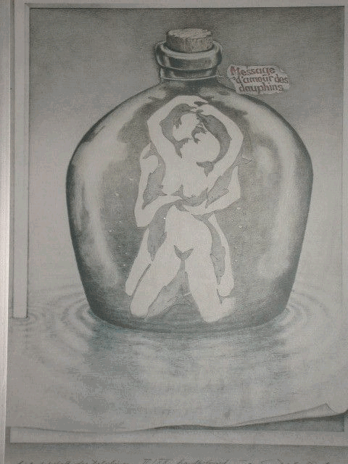
Take a look at the picture? What do you see?
看一下这幅照片，看到什么了？
Research has shown that young children cannot identify the intimate couple because they do not have prior memory associated with such a scenario.
研究结果表明，孩子们看不出这对亲密的夫妻，因为他们没有与之相关的预先记忆。
Children see nine dolphins.
孩子们看到的是9只海豚。
This is a test to determine if you already have a corrupted mind. If it is hard for you to find the dolphins within six seconds, your mind is indeed corrupted.
这个测试用于判断你的头脑是否已被腐蚀。如果你在6秒之内还难以看到海豚的话，你的头脑的确遭到了腐蚀。

Slide 4

Optical Illusions and Visual Phenomena
幻觉和视觉现象
Want to confuse your eyes and brain a bit?
想让你的眼睛和大脑陷入迷乱？那么看一下下面的图片...
Yes? Then you might want to have a look at the following pics ..

Slide 5
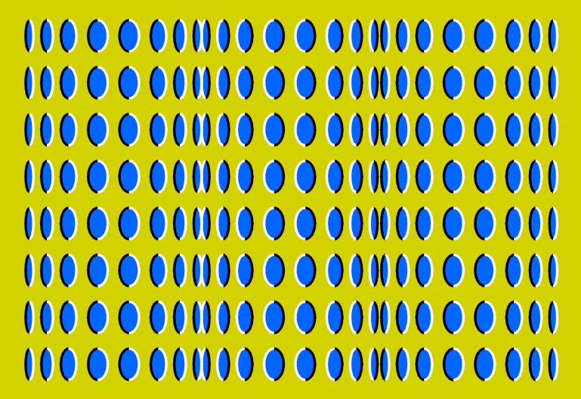
It ...这幅图..

Slide 6
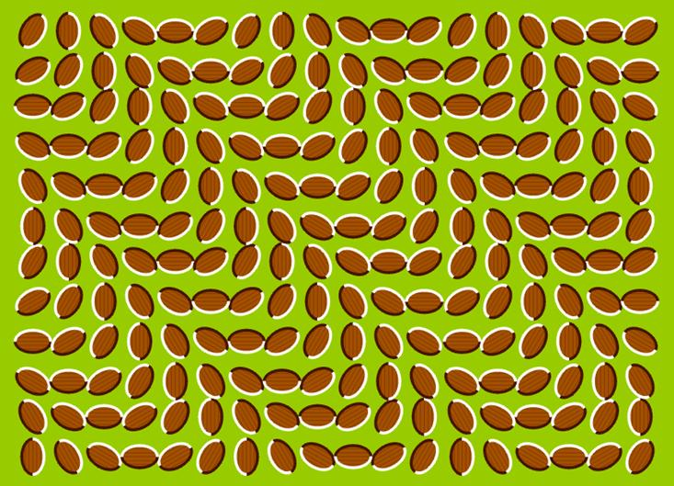
… doesn‘t move! 它没有动！

Slide 7
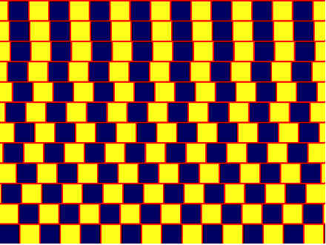
... parallel or not? 这些线是平行的吗？

Slide 8
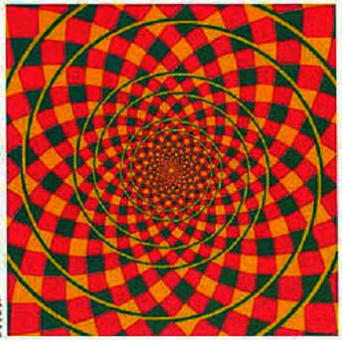
Coil or circle? 是螺旋的还是圆形的？（--当然是圆形的）

Slide 9

Concentrate on the cross in the middle, after a while you will notice that this moving purple dot will turn green!
把目光集中在中间的+字，你会发现，移动的紫点会变绿
Look at the cross a bit longer and you‘ll notice that all dots except the green one will disappear.
盯住十字形，时间再长一点，你会发现，除了绿色的点外，其他所有的点都消失了。

Slide 10
Best things last ...
最后是最好的东东...

Slide 11

Follow the instruction below. 按照下面的指引
1) Stare at the 4 little dots on the middle of the picture for 30 seconds
盯住图片中间的4个小点，坚持30秒
2) then look at a wall near you 然后往你附近的墙上看
3) a bright spot will appear 会出现一个明亮的东西
4) twinkle a few times and you‘ll see a figure 闪过几次后，你会看到一个头像
5) What do you see? Or even WHO do you see? 看到什么了？或者说，你看到谁了？

